Slide 1



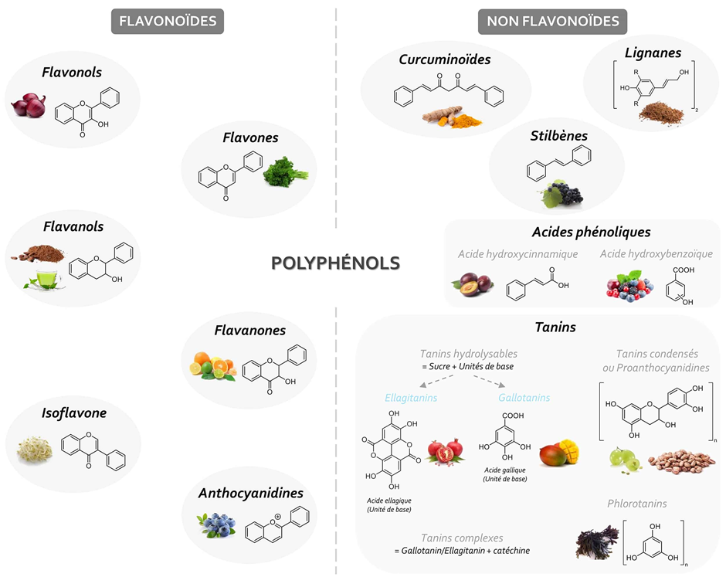





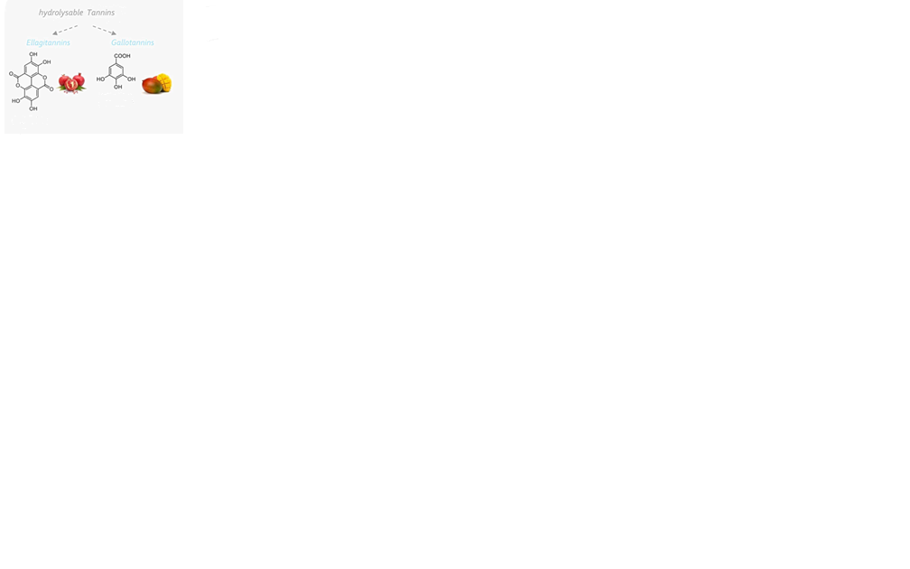

Phenolic acids
Condensed tannins
or Proanthocyanidins

